Slide 1
IBM Applied Data Science Capstone Project
Capstone Project By
Mohammad Ashraf Ansari

Slide 2

OUTLINE
Executive Summary
Introduction
Methodology
Data collection
EDA (viz & sql)
Classification prediction
Results
Visualization – Charts
Dashboard
Discussion
Findings & Implications
Conclusion
Appendix

Slide 3

EXECUTIVE SUMMARY
SpaceX is a leading company in making spacecrafts, their major achievement is that they can sometimes land stage one rocket launchers again instead of losing them, bringing the cost way down.
This report is aimed at looking at the historical launches of SpaceX rockets to investigate the success rate of landing, and if it’s correlated to
Location
Payload Mass
Booster type

Slide 4

INTRODUCTION
SpaceX doesn’t attempt to land each launched rocket
So, it’s useful to investigate and see if we can predict if SpaceX will have a successful landing for a future launch or not.
SpaceX historical launch data is a good starting point

Slide 5

METHODOLOGY
We collect SpaceX launch historical data, through their API
We perform Exploratory data analysis to see which factors contribute to the success or failure of the landing
We isolate these features, wrangle the data and standardize it.
We use classification algorithms to see which one has the highest accuracy.

Slide 6
Data collection
SpaceX API
We request the historical data from this url: https://api.spacexdata.com/v4/launch es/past
Here’s the notebook for data
collection:
https://github.com/asrf007/capstone-project
We request the data from the API using request.get()
We normalize the JSON data with pandas’ function json_normalize()
We get the dataframe and start wrangling the data

Slide 7
Data Cleaning
Data Cleaning
We select only the columns relevant to our analysis; excluding ids, links, images and other irrelevant columns
SpaceX API
We clean the data and wrangle the data for feature engineering as preparation for the analysis.
We filter the data for Falcon 9 Launches only.

Slide 8
Data Wrangling
Data Wrangling
We check missing data, and replace it with appropriate substitute; in our case, we replace missing payload mass with the average.
We define a column for the output, to be 0 if failure and 1 if success.
SpaceX API
We clean the data and wrangle the data for feature engineering as preparation for the analysis.
Here’s the notebook for data
wrangling:
https://github.com/asrf007/capstone-project

Slide 9
EDA with data visualization
In this notebook, we perform preliminary EDA with some visualization to get an idea about the relationship between different factors and success rate. So, we visualize the following:
The number of flights and payload mass
Launch site and flight number
Payload mass and launch site
Success rate and orbit
The number of flights and payload mass
Flight number and orbit
Payload and orbit
Launch success yearly trend

Slide 10
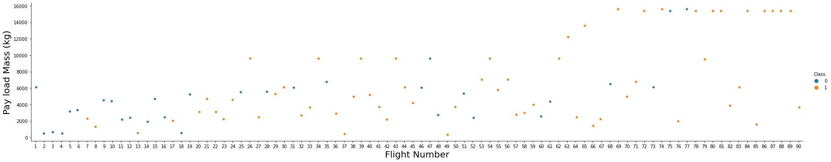
Correlation trends
Relationship between Flight number, and Payload Mass

Slide 11
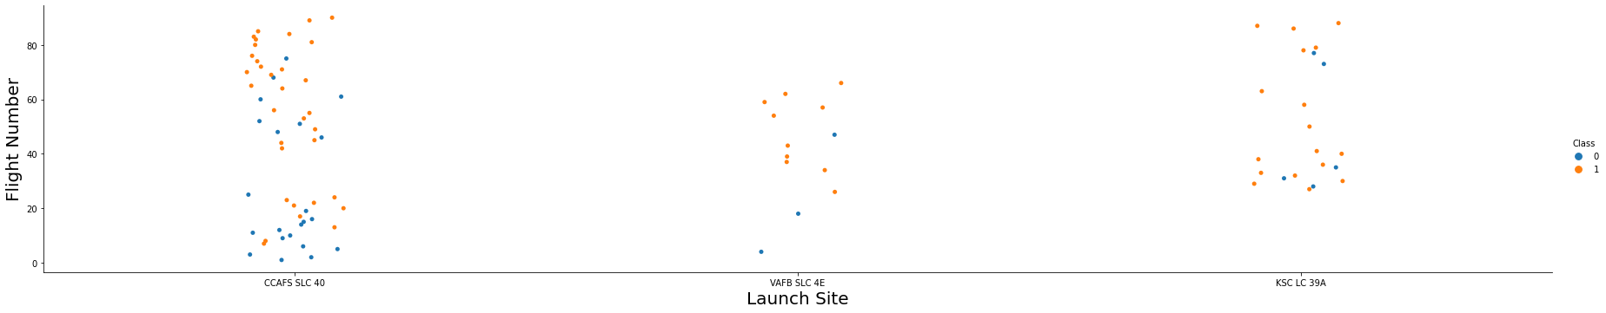
Correlation trends
Relationship between Flight number, and Launch Site

Slide 12
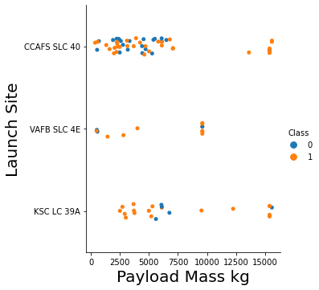
Correlation trends
Relationship between Launch Site, and Payload Mass
We can see that the launch site “VAFB SLC 4E” doesn’t
have launches with heavy payloads

Slide 13
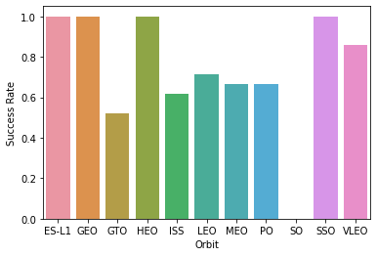
Correlation trends
Success rate for each orbit

Slide 14
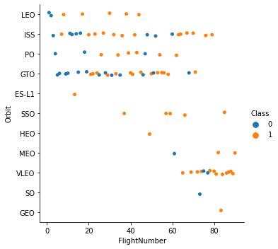
Correlation trends
Relationship between Flight number and orbit type

Slide 15
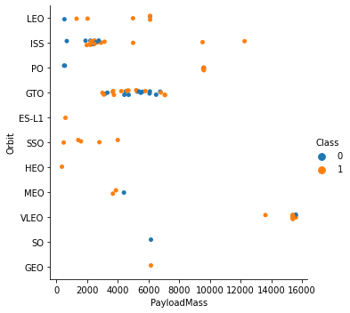
Correlation trends
Relationship between Payload mass and orbit type

Slide 16
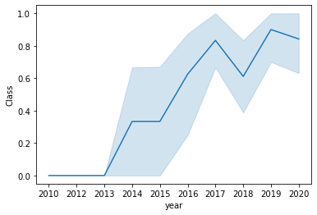
Correlation trends
Success rate yearly trend

Slide 17
EDA with SQL
In this notebook, we perform preliminary EDA with some SQL queries. We first upload the data in the database, establish a connection with the database, and then perform our queries, to accomplish things like:
Listing all unique launch sites
Listing launch sites that begin with CCA
Calculating average payload carried by F9
Getting the date of first successful landing
Getting total number of success and failure
Listing booster versions carrying maximum payload

Slide 18
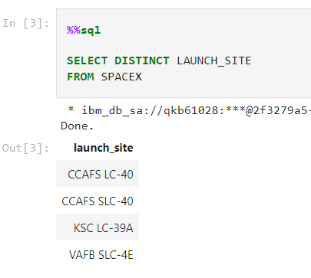
SQL Queries
1- Display the names of the unique launch sites in the space mission

Slide 19
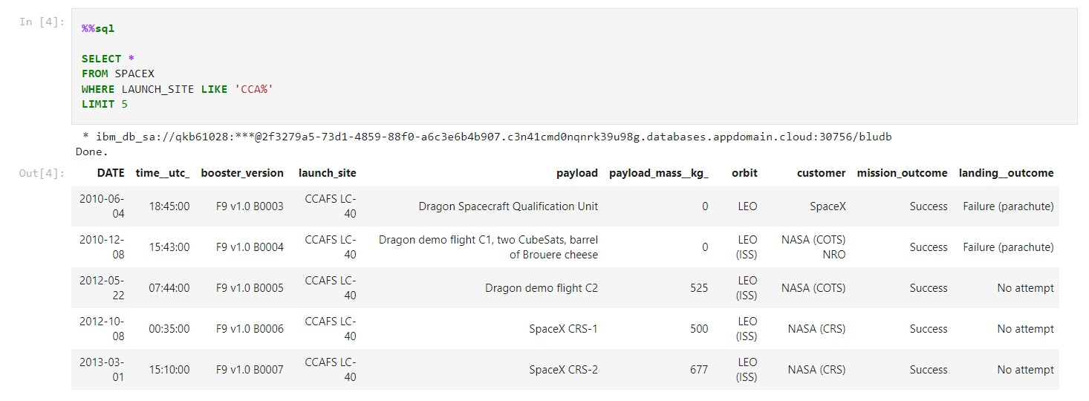
SQL Queries
2- Display 5 records where launch sites begin with the string 'CCA'

Slide 20
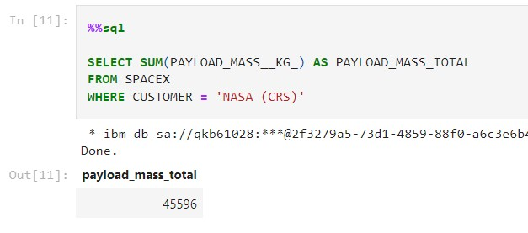
SQL Queries
3- Display the total payload mass carried by boosters launched by NASA (CRS)

Slide 21
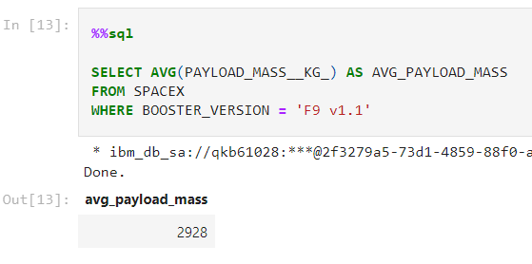
SQL Queries
4- Display average payload mass carried by booster version F9 v1.1

Slide 22
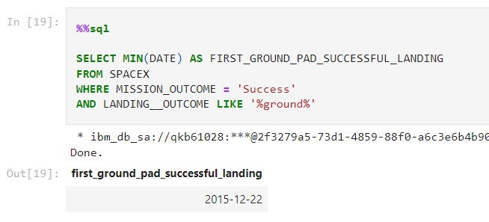
SQL Queries
5- List the date when the first successful landing outcome in ground pad was achieved

Slide 23
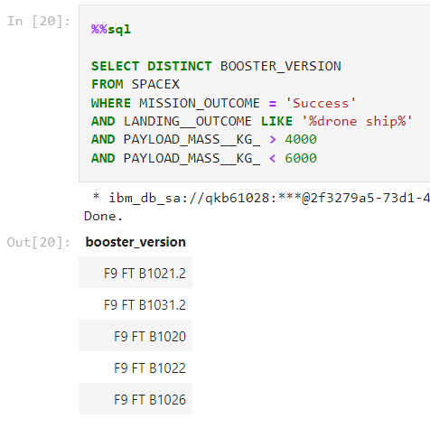
SQL Queries
6- List the names of the boosters which have success in drone ship and have payload mass greater than 4000 but less than 6000

Slide 24
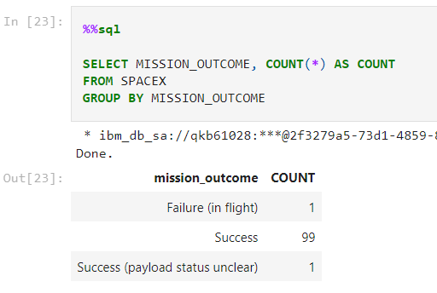
SQL Queries
7- List the total number of successful and failure mission outcomes

Slide 25
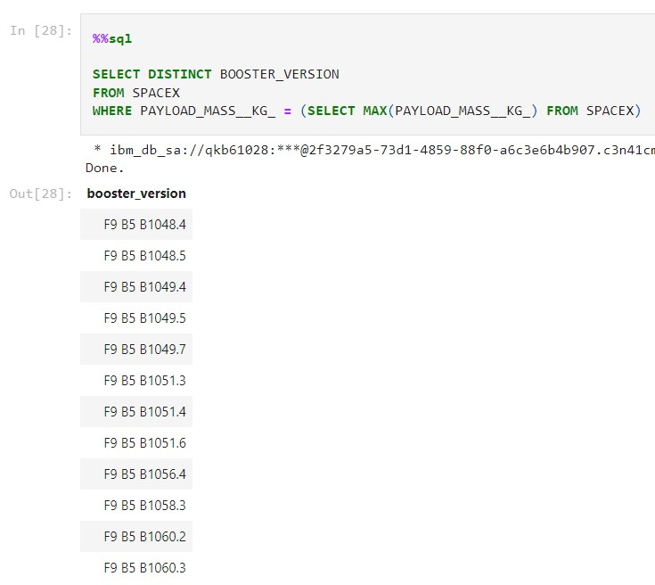
SQL Queries
8- List the names of the booster_versions which have carried the maximum payload mass. Use a subquery

Slide 26
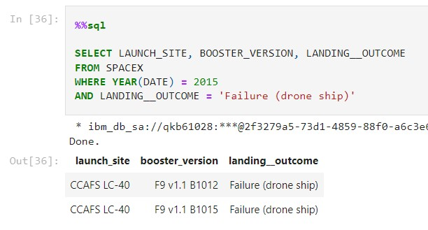
SQL Queries
9- List the failed landing_outcomes in drone ship, their booster versions, and launch site names for in year 2015

Slide 27
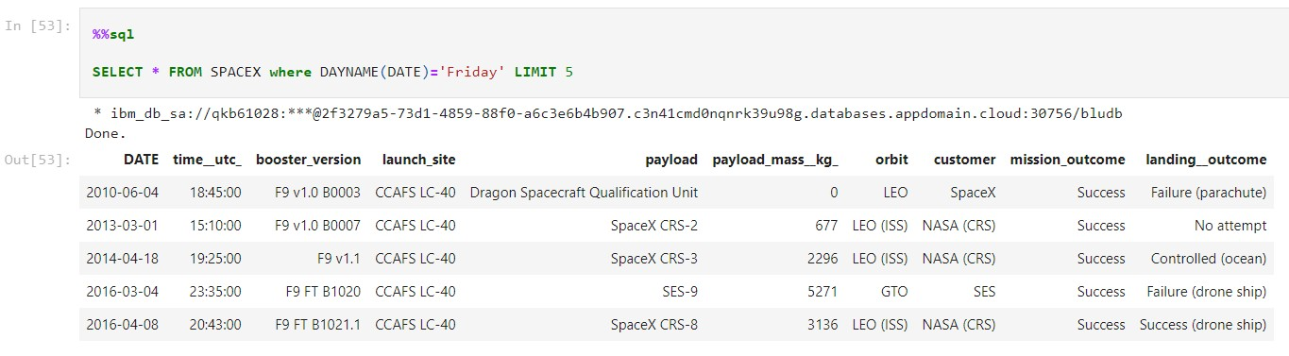
SQL Queries
10- Rank the count of landing outcomes (such as Failure (drone ship) or Success (ground pad)) between the date 2010-06-04 and 2017-03-20, in descending order

Slide 28
EDA with Dashboards
We use folium to create maps to visualize the launch sites geographically, we also create markers on each site to represent successful and failed landings
We also create an interactive dashboard that has graphs to show the success rate of any site of the user’s choosing, and another graph to show the success and failure of different booster types with a payload mass of the user’s choosing.

Slide 29
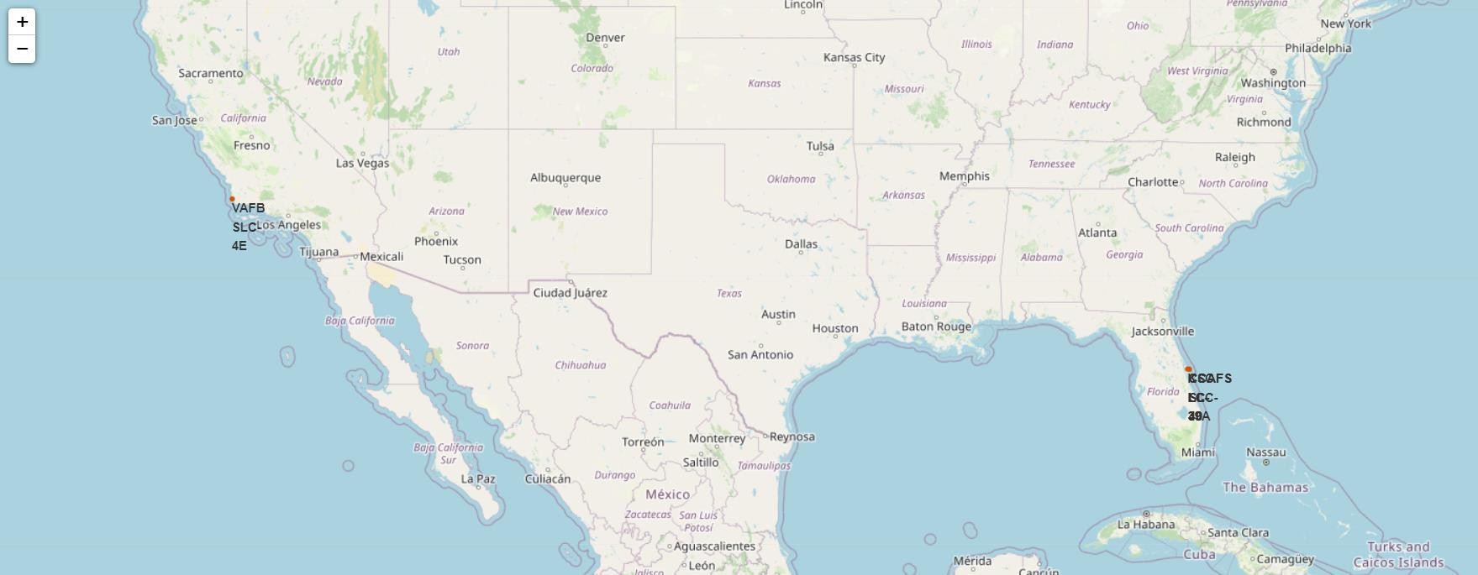
Location characteristics
As we see in the map below, all Launch sites are close to the oceans

Slide 30
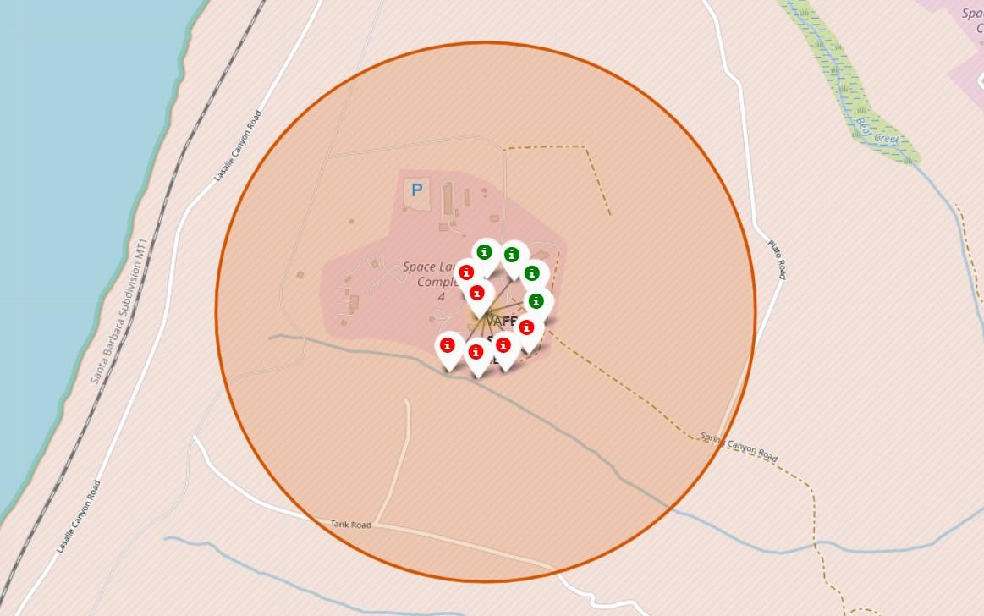
Location characteristics
Zooming in on one of the sites, the VAFB SLC 4E to be specific
The green marks indicate successful landings, and the red ones indicate failures.

Slide 31

DASHBOARD
The following dashboard presents the relationship between Launch Site, success rate, and payload, with interactive mode so you can focus and customize the graph and relationship you want.

Slide 32
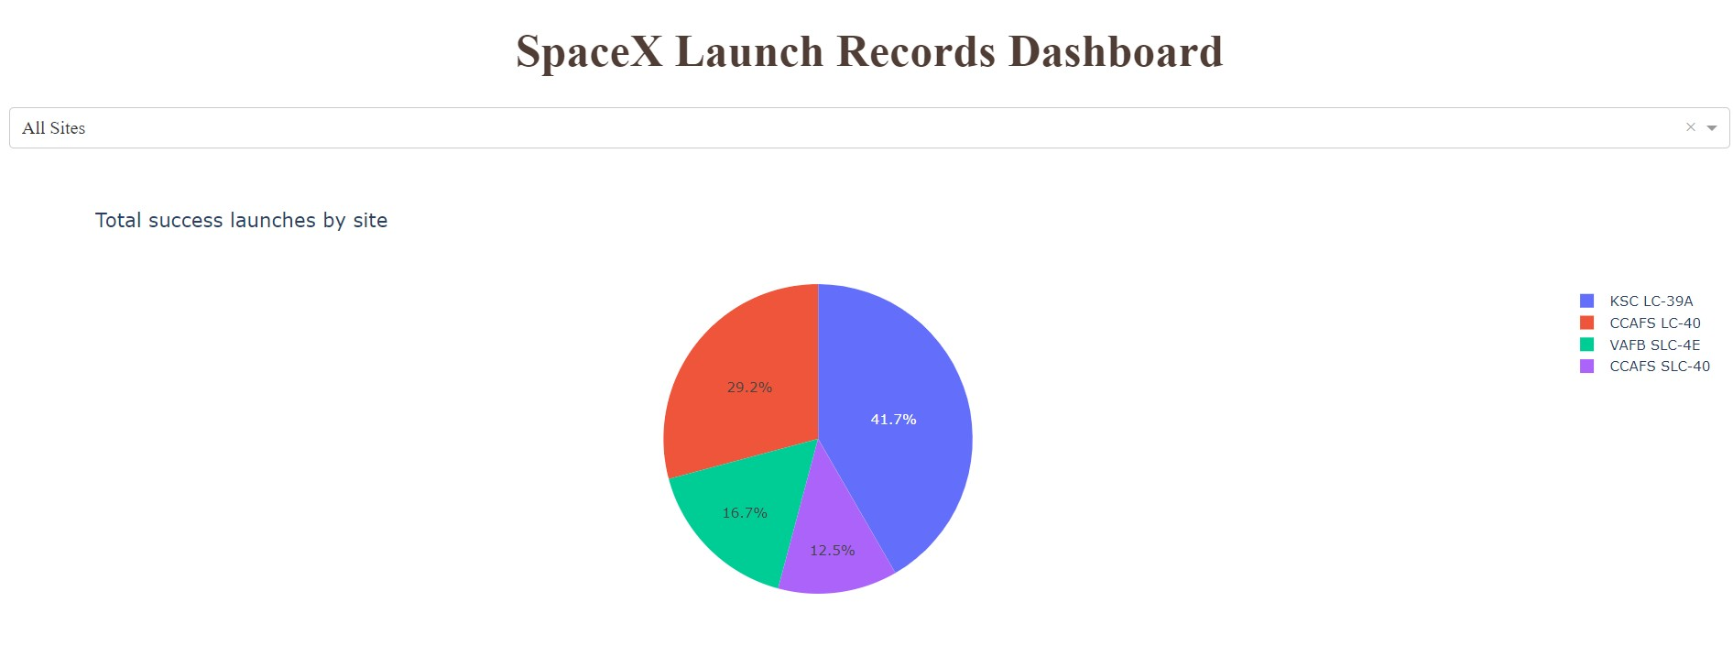
DASHBOARD View 1
Success count for all site

Slide 33
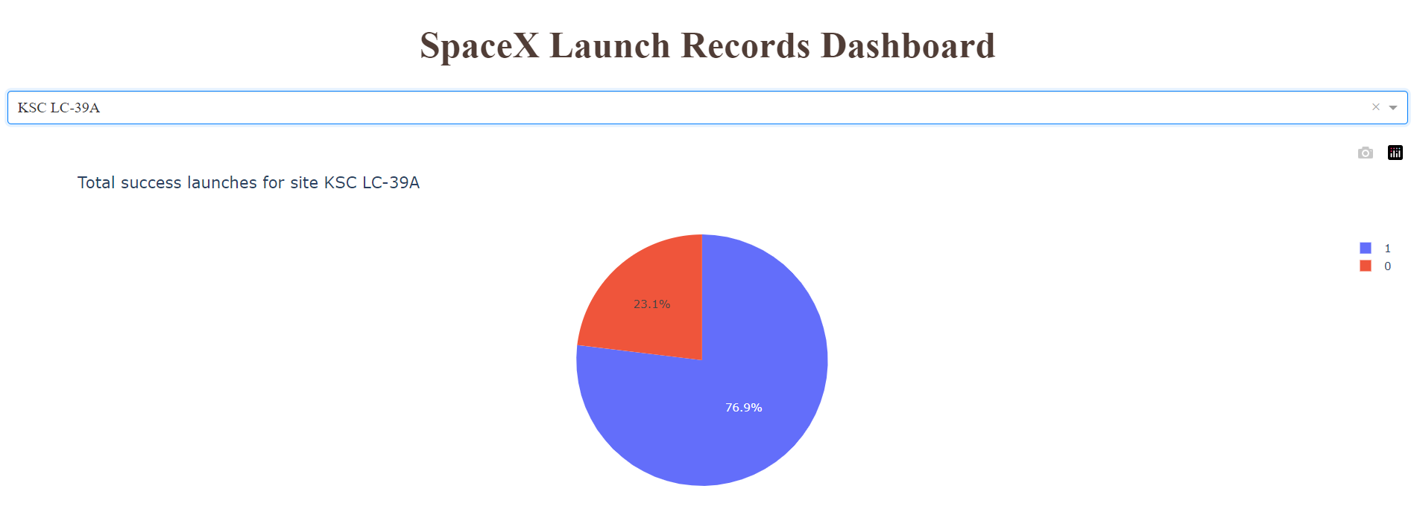
DASHBOARD View 2
Pie chart representing the launch site with the highest success rate

Slide 34
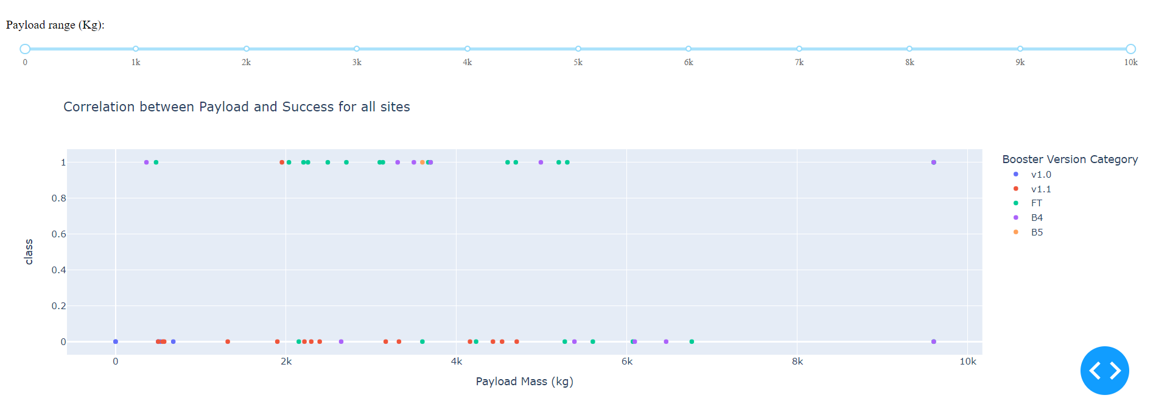
DASHBOARD View 2
Scatter plot of Payload mass vs launch outcome, colored by booster version category

Slide 35
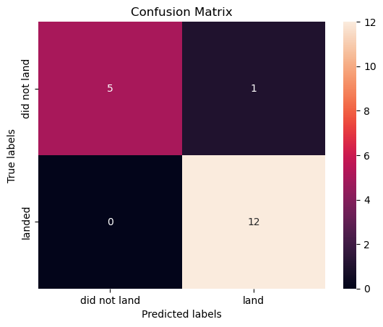
Predictive analysis
We finally build a model using classification algorithms to predict the success or failure of future launches.
We try these algorithms:
Logistic regression
Support vector machine
Decision Tree
K Nearest Neighbors
Here’s the confusion matrix of the predicted values using the best model on test data:

Slide 36




CONCLUSION
With sufficient data, we can somewhat accurately predict the success or failure of future launches.
If a competitor wants to enter the market, they should tune to specific payload mass range, stick to certain orbits, and prefer some launch sites to be able to compete with SpaceX.

Slide 37

APPENDIX
Thank you for your attention.
For all the notebooks and files, please visit:
https://github.com/asrf007/capstone-project

